Slide 1
The (mis)measurement of quality and impact
Paul Wouters

Slide 2

Centre for Science and Technology Studies (CWTS)
Research center at Leiden University focusing on quantitative studies of science (bibliometrics and scientometrics)
Bibliometric contract research
  Monitoring & evaluation
  Advanced analytics
  Training & education

Slide 3
Some initial observations
Research has become a strategic enterprise in which permanent communication is crucial
The relative autonomy of scientific and technical professions has weakened
Both “quality/excellence” and “impact” have become crucial for success at all levels of the scientific system
Peer & expert review and indicator based assessment have become intimately intertwined and mutually shape each other

Slide 4
Research leaders face key questions
How should we monitor our research?
How can we profile ourselves to attract the right students and staff?
How should we divide funds?
What is our scientific and societal impact?
What is actually our area of expertise?
How is our research trans-disciplinary connected?
Notes:
Challenges for research leaders, funding agencies, science policy.
Scientific research has become a strategic and quite enterpreneurial endeavor.
It is no longer sufficient to be good in your own discipline. One needs to balance all sorts of other criteria.
This has created a huge demand for ever more information about research.

Slide 5
Research leaders need strategic intelligence
Increasing demand for information about research:
  hyper competition for funding
  globalization
  industry – academic partnerships
  interdisciplinary research challenges
  institutional demands on research & university management
Increased supply of data about research:
  web based research
  deluge of data producing machines and sensors
  increased social scale of research: international teams
  large scale databases of publications, data, and applications
  citation metrics and altmetrics

Slide 6
New trends in assessment
Increased bibliometric services at university level available through databases
Increased self-assessment via “gratis bibliometrics” on the web (h-index; publish or perish; etc.)
Emergence of altmetrics
Increased demand for bibliometrics at the level of the individual researcher
Societal impact measurements required
Career advice – where to publish?

Slide 8
Key questions on evaluation regimes
Which dimensions of quality are foregrounded in assessments at universities?
How are performance based funding regimes developing?
To what extent is assessment opening up / closing down potential futures?
How does quality/impact assessment shape the process of knowledge creation?
Which “evaluation style” is required for further development of the scientific system?
How are research agendas developed?

Slide 9
Principles for responsible metrics

Slide 10
The norms of science?
The assessment systems don’t measure but create “quality” and “impact”
Traditional normative ideologies of science (eg Merton’s norms of science) still float around but no longer fit with actual behavior
The traditional scientific community can also no longer be the basis for unambiguous norms due to loss of autonomy and the rise of interdisciplinarity
So: on what can we actually base norms for research evaluation?

Slide 11
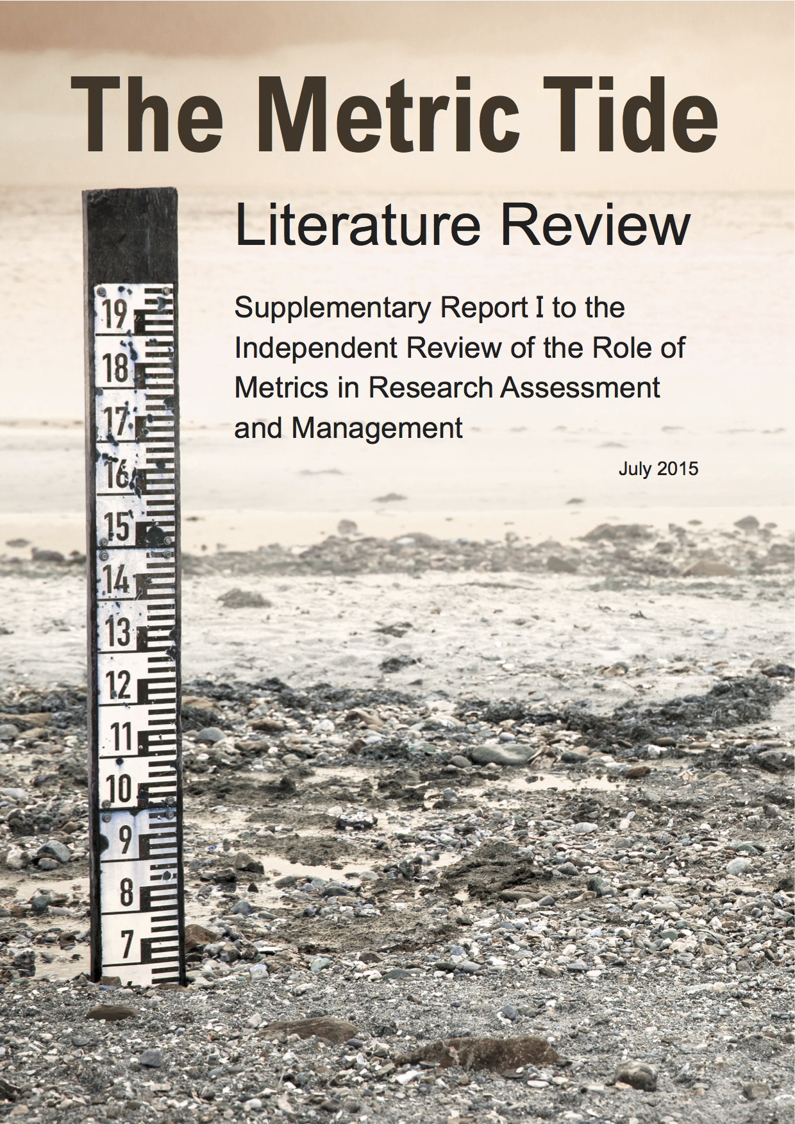
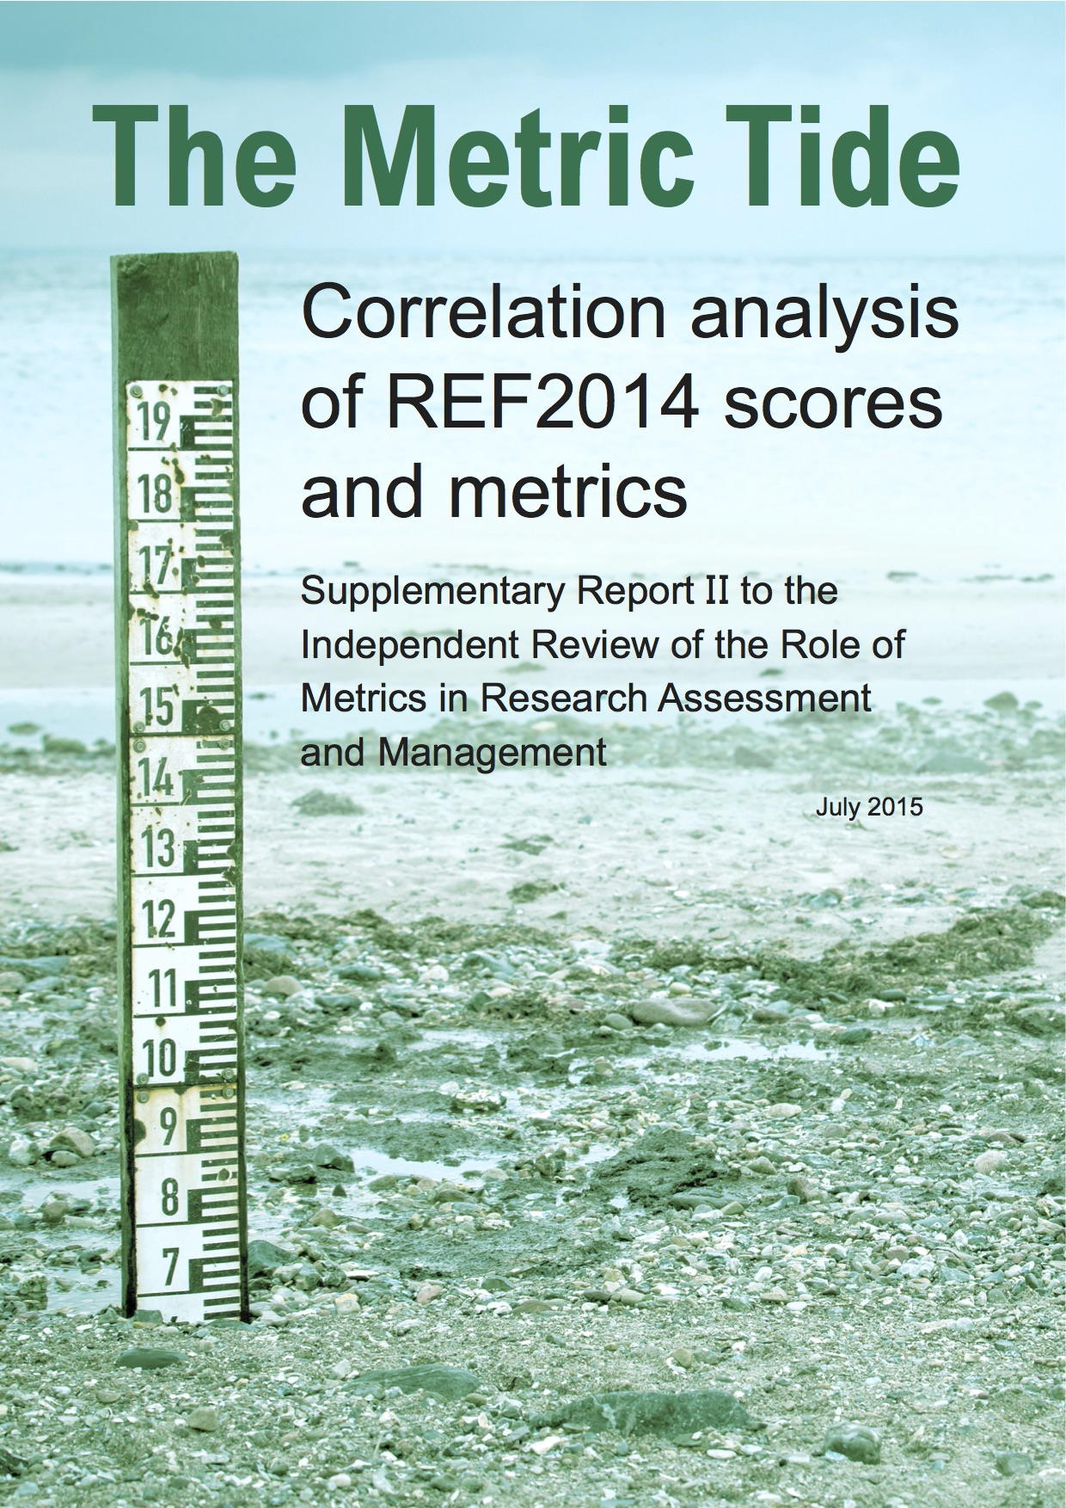
http://www.hefce.ac.uk/rsrch/metrics/

Slide 12

Responsible metrics
Responsible metrics can be understood in terms of:
Robustness: basing metrics on the best possible data in terms of accuracy and scope;
Humility: recognizing that quantitative evaluation should support – but not supplant – qualitative, expert assessment;
Transparency: keeping data collection and analytical processes open and transparent, so that those being evaluated can test and verify the results;
Diversity: accounting for variation by field, using a variety of indicators to reflect and support a plurality of research & researcher career paths;
Reflexivity: recognizing the potential & systemic effects of indicators and updating them in response.
Notes:
Not all the written evidence about the REF we received acknowledged the diversity of purposes of the REF, and there are clearly differences of opinion about the relative importance of the purposes. It is not surprising, therefore, that there are equally different views on how and whether quantitative indicators of research quality should feature in the assessment.
This slide captures some of the overall points and concerns gathered through the process of evidence gathering

Slide 13
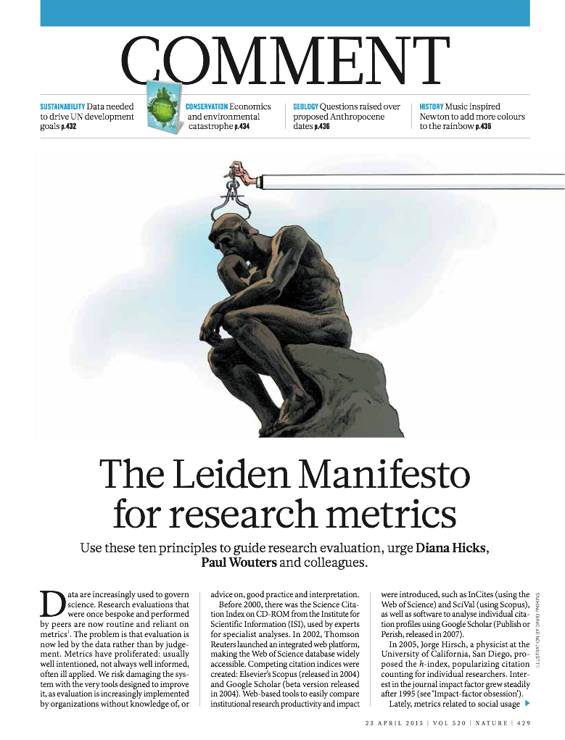
Across the research community, the description, production and consumption of ‘metrics’ remains contested and open to misunderstandings.

Slide 14
The Leiden Manifesto
Quantitative evaluation should support expert assessment.
Measure performance in accordance with the research mission.
Protect excellence in locally relevant research
Keep data collection and analytical processes open, transparent and simple.
Allow for data verification
Account for variation by field in publication and citation practices
Data should be interpreted taking into account the difficulty of credit assignment in the case of multi-authored publications.
Base assessment of individual researchers on qualitative judgment.
False precision should be avoided (eg. the JIF).
Systemic effects of the assessment and the indicators should be taken into account and indicators should be updated regularly
Diana Hicks (Georgia Tech), Paul Wouters (CWTS), Ismael Rafols (SPRU/Ingenio), Sarah de Rijcke and Ludo Waltman (CWTS)

Slide 15
Measuring is changing
What counts as excellence is shaped by how we measure and define “excellence”
What counts as impact is shaped by how we measure and define “impact”
Qualities and interactions are the foundation for “excellence” and “impact” so we should understand those more fundamental processes first
We need different indicators at different levels in the scientific system to inform wise management that strikes the right balance between trust and control
Context crucial for effective data standardization

Slide 16
Context counts
Responsible metrics is not supposed to be a universal standard
Responsible metrics should be responsive and inclusive metrics
Measuring means changing
The context shapes what responsible metrics means:
  the urgency of social problems (poverty, inequality, unemployment and corruption)
  local research and educational missions
  the local appropriation of “the global”
  the values embedded in the policies and communities

Slide 17
Experiments in evaluation

Slide 18

portfolio
aim is to give researchers a voice in evaluation
evidence based arguments
shift to dialog orientation
selection of indicators
narrative component
Good Evaluation Practices
envisioned as web service
expertise
output
narrative
influence

Slide 19
ACUMEN Portfolio
Career Narrative
Links expertise, output, and influence together in an evidence-based argument; included content is negotiated with evaluator and tailored to the particular evaluation
Evaluation Guidelines
aimed at both researchers and evaluators
development of evidence based arguments (what counts as evidence?)
expanded list of research output
establishing provenance
taxonomy of indicators: bibliometric, webometric, altmetric
guidance on use of indicators
contextual considerations, such as: stage of career, discipline, and country of residence
Expertise
- scientific/scholarly
- technological
- communication
- organizational
- knowledge transfer
- educational
Output
- publications
- public media
- teaching
- web/social media
- data sets
- software/tools
- infrastructure
- grant proposals
Influence
- on science
- on society
- on economy
- on teaching

