Slide 1
Opening the black box of national research performance
Kaare Aagaard, Jesper W. Schneider & Thed van Leeuwen
Centre for Research Quality and Policy Impact Studies
(R-Quest)

Slide 2
How do we understand and explain national research performance?
Presentation based on Strand 2a of the R-Quest activities
Longstanding and steadily increasing interest in the scientific performance of nations
Discussions of developments in UK (1980s), Australia (1990s), US (2000s) and more recently in Scandinavia.
However, most existing studies of national research performance have a number of severe limitations

Slide 3
Limitations of most existing studies
The dominant approaches: ”Policy matters” or focus on performance only
These approaches have several important limitations:
1) Take performance measures at face value
2) Insufficient attention to the temporal dimension
3) Over-emphasis on policy factors as core causal mechanisms
4) Neglects the internal dynamics of the global scientific system
Policy
Performance

Slide 4
A Danish Miracle?
A number of systemic imbalancess
Mergers
PhD-reform
Long term stable funding conditions
Excellence funding initiative
Fig. 1: Development in MNCS for Denmark, 3-year overlapping periods, fractionalized counting

Slide 5
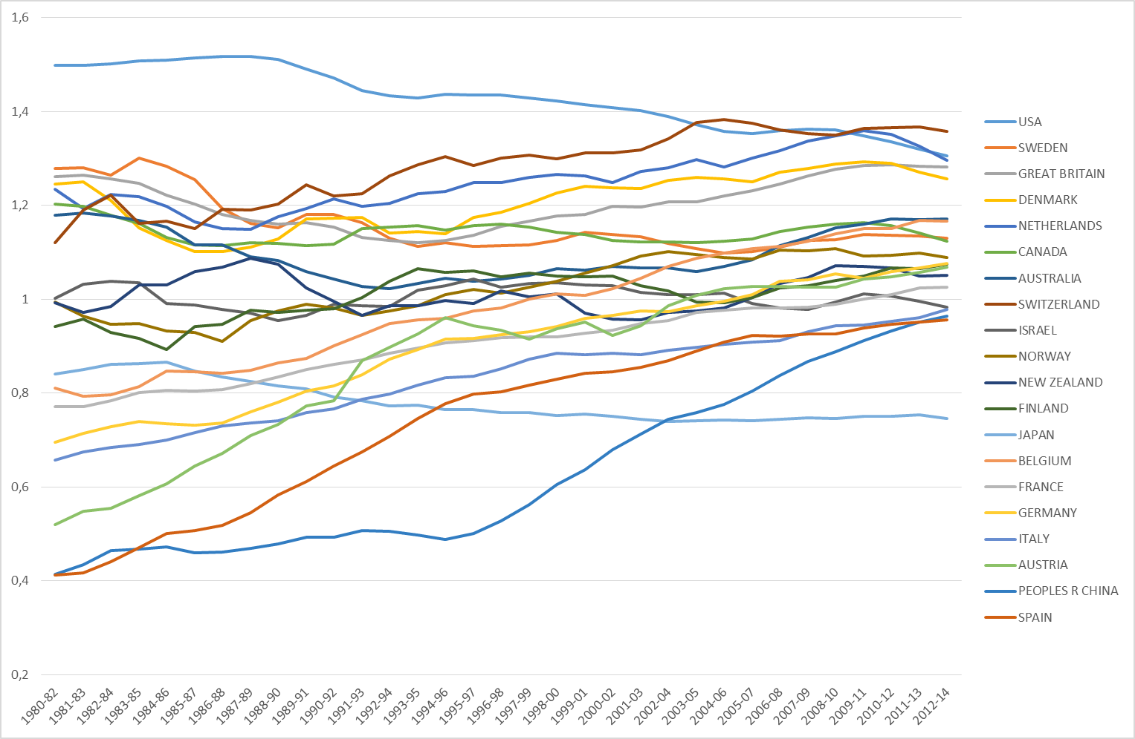
Developments in national research performance
Fig. 2: Development in MNCS for 20 selected countries, 3-year overlapping periods, fractionalized counting

Slide 6
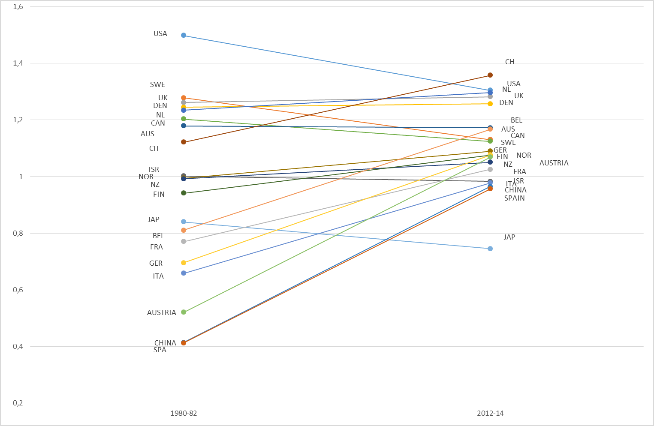
Developments in national research performance
Fig. 3: Changes in positions from 1980-1982 to 2012-2014 for 20 selected countries (based on Figure 2)

Slide 7
Need to move beyond narrow Policy focus
Observations
Remarkable stability in the stratification of the global hierarchy
Same group of high performing nations throughout the period – despite fundamental differences in policy configurations
Implications
Indication of database effects
Indication of mechanisms not directly linked to policy configurations

Slide 8
A More comprehensive approach
To understand aggregated performance developments we need to take the dynamics of three partly connected subsystems into account and pay attention to the interaction between them
The interdependence of various policy-elements
The science system as a self-organising network
The limitations and the dynamic character of WoS
Policy and frame-conditions
The knowledge production system
Tools of measurement
Performance
Feedback-mechanisms

Slide 9
The measurement system
Biases with regard to fields, themes, approaches, language etc.
Measures derived from a dynamic database (an unstable dataset)
Growth in number of journals, number of articles, number of citations
Commercial interests influencing the development of the databases
What do we actually measure and what are the effects of the unstable data-set in relation to longitudinal studies?
Examination of these effects through a fixed set of journals
How does the measuring of science feed back to the policy- and the knowledge production system?

Slide 10
Web of science coverage (denmark)

Slide 11
External and internal factors
Researchers/research groups are not only part of national and institutional policy structures, but also embedded in (international) knowledge communities. Performance is affected by both systems
National policy structures
Institutional policy structures
Individual/research group level
Knowledge networks

Slide 12
The dynamics of the global knowledge production system
Science as a self-organizing network
Preferential attachment, cumulative advantage and gate-keeper mechanisms work to sustain and strengthen stratification at individual, institutional and national levels
Strong historical component (formative moments and path dependency)
Examination of these issues by combining bibliometric network analysis with qualitative historical approaches

Slide 13
The importance of Policy factors?
No magic bullet: Several national policy configurations lead to high system performance
Need to move beyond reductionistic explanations in order to improve our understanding of the interplay between different policy factors
Stable and balanced policy conditions may be a necessary condition for high performance, but these factors are (at best) only partial explanations
In other words: Policy-centered approaches are missing something

Slide 14
Why policy does not matter (that much) for the high performing part of national systems
For DK 60% of citations within each field given to top 10% of all publications: Thus, only a limited part of the overall system determines the overall national ranking
Most top 10 publications are international
Less affected by national policy changes: variety of external funding sources, autonomy, access to international networks, cumulative advantages
Clinical medicine constitutes a large part of the research covered by WoS, but is in many countries partly detached from the general science policy framework

Slide 15
Why policy still matters after all…
In the rest of the science system policy changes often have a very direct effect. In particular:
where funding is a scarce ressource
where protected space is limited
where local problems/questions are important
where subjects, theories or methods fall outside of the mainstream
The publication indicator as an example of a policy mechanism of limited importance for the elite layer, but quite influential for the rest
But policy may also have very real effects for the high performing parts of the system if we look at the long term – in particular for the coming generations

Slide 16
Concluding remarks
Need for a broad approach to studies of national research performance
Overemphasis on policy as main causal factor and neglect of the path dependent and self-reinforcing nature of the global scientific network
Lack of knowledge of the effects of the database changes for longitudinal studies
Policy implications
Policies do not affect all parts of national systems uniformly
Different approaches are needed to target different segments of the science system
If we want to target the elite layer of the science system we need to pay attention to network dynamics and gate-keeper mechanisms, rather than to local incentives

Slide 17
Thank you for your attention!

